Slide 1

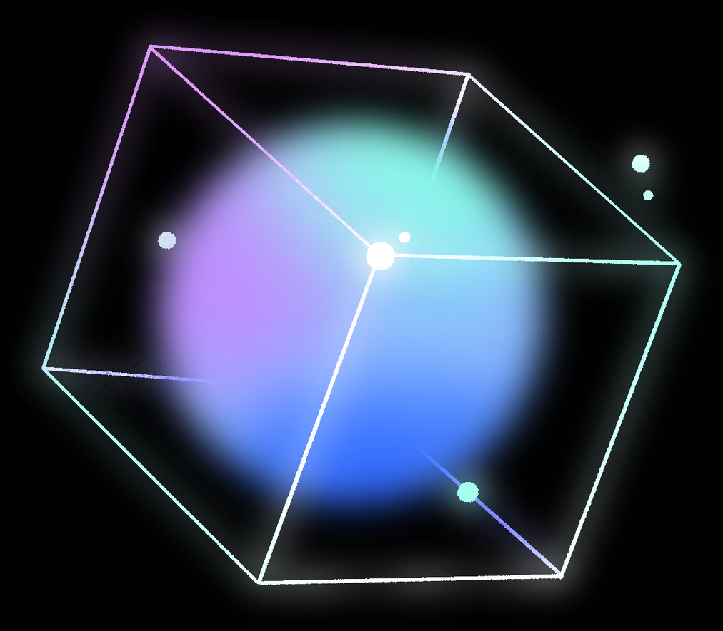




FINAL PROJECT
S.SATHRAK STUVET
sathrakstuvet51@gmail.com
BE CSE
NM ID:au963321104047

Slide 2
PROJECT TITLE:
IMAGE ACCURACY FINDER IN TENSORFLOW USING CNN

Slide 3

AGENDA
Image classification is a fundamental task in computer vision with applications ranging from medical diagnosis to autonomous vehicles. Convolutional Neural Networks (CNNs) have emerged as a powerful tool for image classification due to their ability to automatically learn hierarchical features from raw pixel data. In this project, we propose a CNN-based approach for image classification, leveraging deep learning techniques to accurately classify images into predefined categories. We explore different architectures and hyperparameters to optimize the model's performance on various datasets. Additionally, we investigate techniques such as data augmentation, transfer learning, and fine-tuning to enhance the robustness and generalization capabilities of the model. Experimental results demonstrate the effectiveness of our approach in achieving high classification accuracy across different image datasets. This project contributes to advancing the state-of-the-art in image classification and lays the groundwork for future research in this domain.

Slide 4


PROBLEM STATEMENT
The project aims to develop a system that can accurately identify objects or patterns in images using Convolutional Neural Networks (CNNs). We're focusing on building a model that can learn to recognize different objects, like animals or vehicles, and classify them correctly. The main challenges we're tackling include making sure the model can work well with all kinds of images, even ones with different lighting or angles, and making it efficient enough to handle large amounts of data quickly. Ultimately, the goal is to create a reliable system that can be used in various applications, like helping self-driving cars detect obstacles or assisting doctors in medical image analysis.

Slide 5
PROJECT OVERVIEW
The project involves building an image classification system using Convolutional Neural Networks (CNNs). The system aims to accurately recognize objects in images. It begins with gathering a variety of images to train the model, followed by preprocessing steps like resizing and normalization. Then, the model is trained to learn patterns and features in the images associated with specific categories. Once trained, the system can classify new images into these categories with high accuracy, aiding in various applications like object recognition and scene understanding.

Slide 6



WHO ARE THE END USERS
The end users for the project would encompass a wide range of individuals and organizations across different domains who rely on image classification capabilities for their specific needs. This could include researchers and academics in fields such as biology, astronomy, or environmental science, who require tools for analyzing and categorizing images for their research. Additionally, professionals in industries like healthcare, where medical image analysis is crucial for diagnosis and treatment planning, would benefit from the project's capabilities. Furthermore, engineers and developers working on applications such as autonomous vehicles, security surveillance, or content-based image retrieval systems could utilize the image classification system to enhance their products and services. Overall, the project aims to cater to the diverse needs of end users who rely on accurate and efficient image classification technology.

Slide 7

YOUR SOLUTION AND IT’S VALUE PRPOSTION
Project Solution:
Data Preparation: Curate annotated image dataset -
Model Development: Implement deep learning models (CNNs)
Evaluation and Optimization: Rigorous model evaluation and fine-tuning
Deployment and Integration: Deploy models into production environments
Value Proposition:
Efficiency: Streamline workflow processes
Accuracy: Ensure consistent and reliable categorization
Scalability: Handle large volumes of image data
Cost-effectiveness: Reduce manual labor and human error
Versatility: Applicable across diverse industries

Slide 8

THE WOW IN YOUR SOLUTION
The "wow" factor in the proposed solution lies in its seamless integration of cutting-edge technology with practical applications, offering a robust and efficient image classification system with several standout features. Leveraging Convolutional Neural Networks (CNNs) and advanced deep learning techniques, the solution ensures state-of-the-art accuracy in categorizing images into predefined classes. This accuracy is achieved through the model's capability to learn intricate patterns and features within images, enabling it to make highly accurate predictions even on complex datasets. Additionally, the solution's robustness and generalization capabilities ensure reliable performance across diverse image characteristics, including varying lighting conditions, viewpoints, and occlusions. Its scalability allows for efficient handling of large-scale datasets, while its user-friendly interface simplifies interaction for end users. The versatility of the solution enables its deployment across various industries and applications, catering to a wide range of needs and use cases. Overall, the solution's combination of accuracy, robustness, efficiency, and versatility makes it a standout choice for image classification tasks, offering unparalleled performance and value to users.

Slide 9

MODELLING
In the modeling phase, we create the heart of our image classification system: the Convolutional Neural Network (CNN). Think of the CNN as a sophisticated pattern recognition system inspired by the human brain's visual cortex. We train this network using our curated dataset, teaching it to recognize patterns and features that distinguish one image category from another. Through a process called backpropagation, the CNN adjusts its internal parameters to minimize prediction errors, gradually improving its ability to accurately classify images. This modeling phase is where the magic happens, as our CNN learns to see the world much like we do, albeit through the lens of pixels and mathematical algorithms.

Slide 10
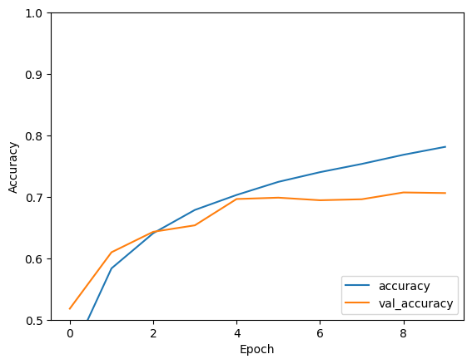
RESULTS
DEMOLINK: https://colab.research.google.com/github/tensorflow/docs/blob/master/site/en/tutorials/images/cnn.ipynb#scrollTo=gtyDF0MKUcM7

